Slide 1
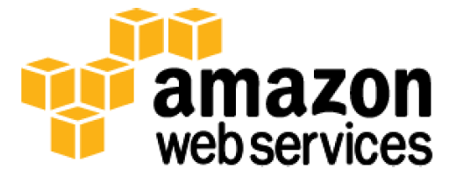
AWS Networking Services
Lesson 09: AWS Networking services
Notes:
Add instructor notes here.

Slide 2
Lesson Objectives
In this lesson, you will learn:
Amazon VPC
Amazon Route 53
AWS Direct connect
Amazon CloudFront
Notes:
Amazon VPC
Amazon Route 53
AWS Direct connect
Amazon CloudFront
This lesson is to give an Introduction on Java Server Pages

Slide 3
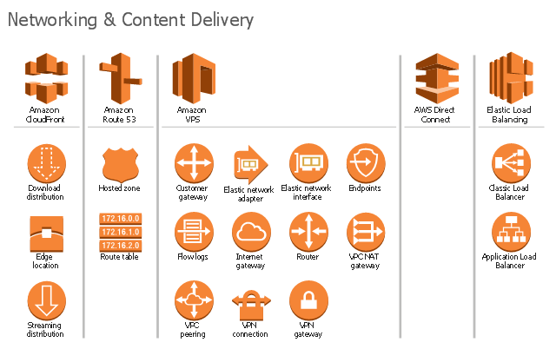
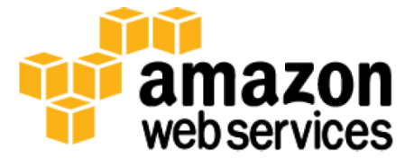
9.1: Amazon VPC AWS Networking and Content Delivery

Slide 4
9.1: Amazon VPC Amazon Networking Services
AWS networking products enable user to isolate it’s cloud infrastructure
It scale the request handling capacity, and connect your physical network to your private virtual network.
AWS networking products work together to meet the needs of your application .
Example : Elastic Load Balancing works with Amazon Virtual Private Cloud (VPC) to provide robust networking and security features
Notes:
AWS networking products enable you to isolate your cloud infrastructure, scale your request handling capacity, and connect your physical network to your private virtual network.
AWS networking products work together to meet the needs of your application. For example, Elastic Load Balancing works with Amazon Virtual Private Cloud (VPC) to provide robust networking and security features.

Slide 5
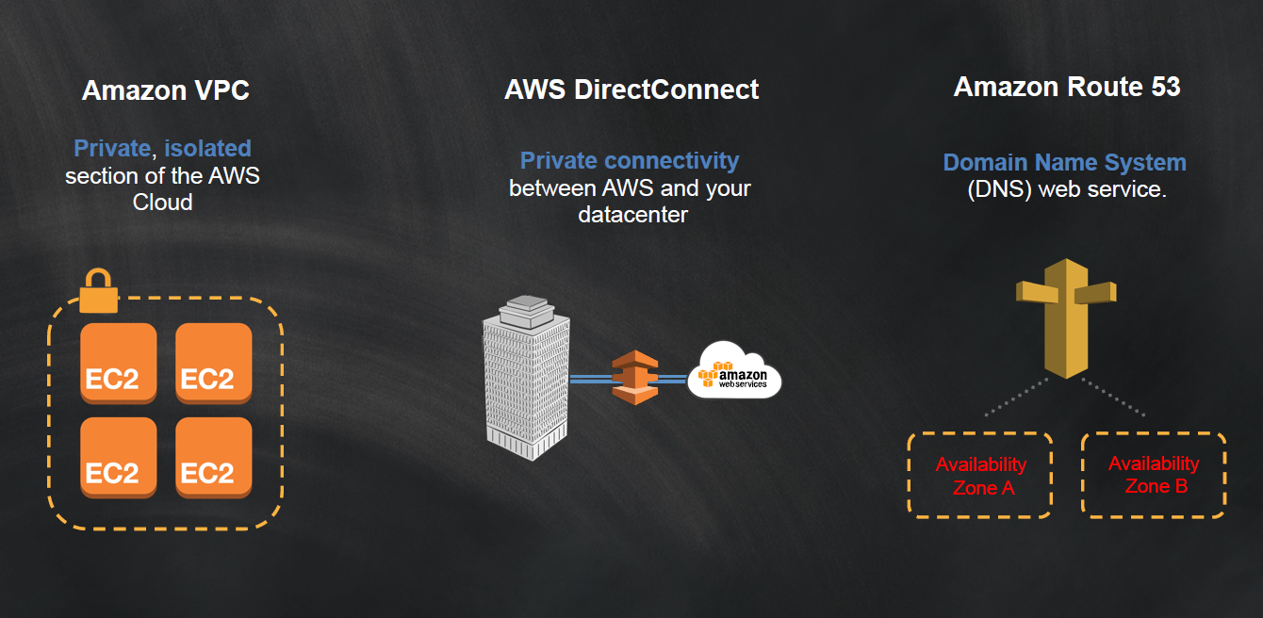
9.1: Amazon VPC AWS Networking Services

Slide 6
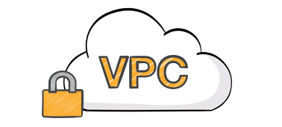
9.1: Amazon VPC Amazon VPC(Virtual Private Cloud)
It isolates cloud resources with your own private virtual network where you can launch AWS resources in a virtual network that you define
One can have complete control over it’s virtual networking environment, which includes
Selection of own IP address range,
creation of subnets,
Configuration of route tables and network gateways.
You can use both IPv4 and IPv6 in your VPC for secure and easy access to resources and applications.
Notes:
You have complete control over your virtual networking environment, including selection of your own IP address range, creation of subnets, and configuration of route tables and network gateways. You can use both IPv4 and IPv6 in your VPC for secure and easy access to resources and applications.
You can easily customize the network configuration for your Amazon VPC. For example, you can create a public-facing subnet for your web servers that has access to the Internet, and place your backend systems such as databases or application servers in a private-facing subnet with no Internet access. You can leverage multiple layers of security, including security groups and network access control lists, to help control access to Amazon EC2 instances in each subnet.
Additionally, you can create a Hardware Virtual Private Network (VPN) connection between your corporate data center and your VPC and leverage the AWS Cloud as an extension of your corporate data center.

Slide 7
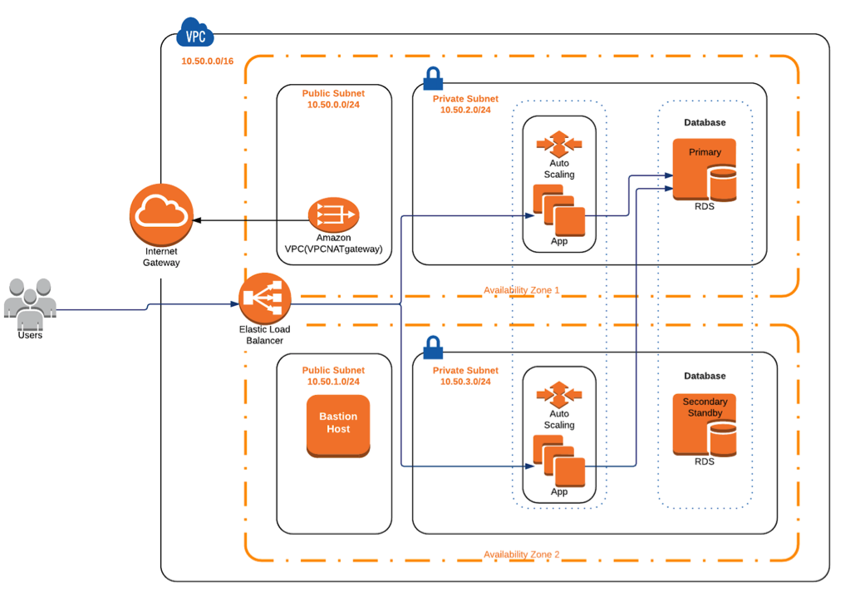
9.1: Amazon VPC Amazon VPC(Virtual Private Cloud)
One can easily customize the network configuration for your Amazon VPC.
Notes:
For example, one can create a public-facing subnet for your web servers that has access to the Internet, and place your backend systems such as databases or application servers in a private-facing subnet with no Internet access.
One can apply multiple layers of security, including security groups and network access control lists, to help control access to Amazon EC2 instances in each subnet.
One can store data in Amazon S3 and restrict access
so that it’s only accessible from instances in your VPC.

Slide 8
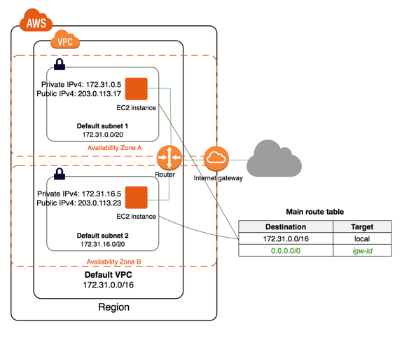
9.1: Amazon VPC Amazon VPC(Virtual Private Cloud)
Notes:
You can easily customize the network configuration for your Amazon VPC. For example, you can create a public-facing subnet for your web servers that has access to the Internet, and place your backend systems such as databases or application servers in a private-facing subnet with no Internet access. You can leverage multiple layers of security, including security groups and network access control lists, to help control access to Amazon EC2 instances in each subnet.
Additionally, you can create a Hardware Virtual Private Network (VPN) connection between your corporate data center and your VPC and leverage the AWS Cloud as an extension of your corporate data center.

Slide 9
4.1: Amazon VPC Features and Benefits
Connect directly to the Internet (public subnets)
Connect to the Internet using Network Address Translation (private subnets)
Connect securely to your corporate datacenter
Privately connect to AWS Services without using an Internet gateway, NAT or firewall proxy through a VPC Endpoint.
Privately connect your internal services across different accounts and VPCs within your own organizations, significantly simplifying your internal network architecture.
Notes:
one can launch instances into a publicly accessible subnet where he/she can send and receive traffic from the Internet.
Private subnets can be used for instances that you do not want to be directly addressable from the Internet. Instances in a private subnet can access the Internet without exposing their private IP address .
All traffic to and from instances in your VPC can be routed to your corporate datacenter over an industry standard, encrypted IPsec hardware VPN connection.

Slide 10
9.1: Amazon VPC Amazon VPC implementation
One can create a VPC quickly and easily using the AWS Management Console.
You can select one of the common network setups that best match your needs and press "Start VPC Wizard."
Subnets, IP ranges, route tables, and security groups are automatically created for you so you can concentrate on creating the applications to run in your VPC
Notes:
You can create a VPC quickly and easily using the AWS Management Console. You can select one of the common network setups that best match your needs and press "Start VPC Wizard." Subnets, IP ranges, route tables, and security groups are automatically created for you so you can concentrate on creating the applications to run in your VPC.

Slide 11
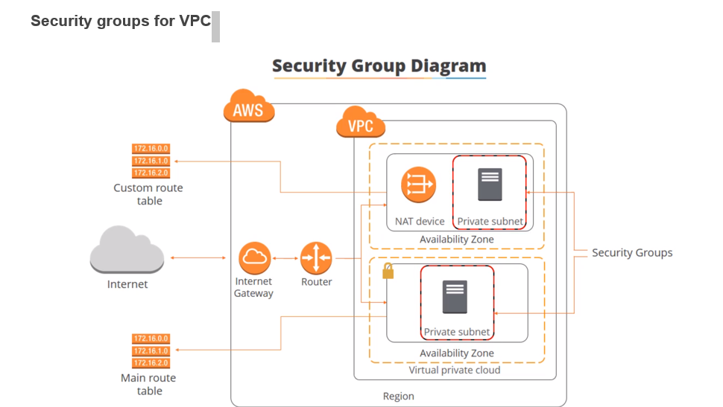
9.1: Amazon VPC Amazon VPC implementation
Notes:
Steps to create Custom VPC :
Follow the Steps to create Custom VPC
Step1 : After login in AWS choose the VPC under Networking Service.
Step 2 : From Dashboard click on VPC link and click on create VPC button
Step 3 : Provide the details and Click on Create VPC button
Name - <<VPC name>>
IPV4 CIDR block - 10.0.0.0/16
IPV6 – will be default
Tenancy - Default
Step 4 : Click on Yes Create button and see your VPC . (you can see the default root table is associated with your VPC , which brings local traffic.
Step 5 : Go to Subnet section in VPC dashboard and check no Subnet is associated to your VPC
Follow the Steps to create Elastic IP address
Step 6 : Click on Elastic IP link in VPC dash board and click on allocate new address button.
Step 7 : Note the new IP address.

Slide 12
9.1: Amazon VPC Demo
Demo on:
Creating Amazon VPC ( Refer the Steps given in Notes section )
Notes:
Follow the Steps to create Subnetmask
Step 8 : Click on subnetmask link in VPC dashboard and click on
Create subnet button.
Step 9 : provide the details to create a public subnet and click on create button
VPC – Your Custom VPC , you created
Availability Zone – Select 1 from drop down list
IPV4 CIDR block - 10.0.1.0/24
Name tag – As per CIDR block give
Step 10 : Repeated step 8 and 9 to create a private subnet in different AZ(ap-southeast-1c).
Step 11 : Repeat step 8 and 9 to create a public subnet in different AZ(ap-southeast-1c).
Step 11 : View all the subnets
Follow the Steps to create Internet gateway
Step 12 : Click on Internet gateway from VPC dashboard and “choose one” option
Step 13 : provide a tag name for Internet gateway
Step 14 : Go to Action and Attach to Custom VPC
Follow the Steps to create Route table
Step 15 : Go to route tables option on the left pane , click create route
table, select your VPC and click create.
Step 16 : Select the route table and associate it with your subnet which has to be made public.
Step 17 : Route tables entry should have 0.0.0.0/0 as destination and internet gateway as target.
Step 18 : Now you will be able to connect the ec2 instances launched in the public subnet (10.0.1.0/24) using the public ip or an elastic ip

Slide 13

9.2: Amazon Route 53 Amazon Route 53
Product Type : -- Domain Name Service (DNS)
It is a highly available and scalable cloud Domain Name System (DNS) web service.
A DNS service such as Amazon Route 53 is a globally distributed service that translates human readable names like www.example.com into the numeric IP addresses like 192.0.2.1 that computers use to connect to each other.
Notes:
Scalable Domain Name System
Amazon Route 53 is a highly available and scalable cloud Domain Name System (DNS) web service. It is designed to give developers and businesses an extremely reliable and cost effective way to route end users to Internet applications by translating names like www.example.com into the numeric IP addresses like 192.0.2.1 that computers use to connect to each other.

Slide 14
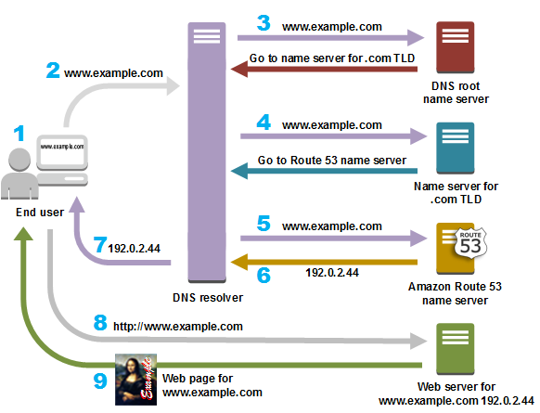
4.2: Amazon Route 53 Amazon Route 53
Notes:
A user opens a web browser, enters www.example.com in the address bar, and presses Enter.
The request for www.example.com is routed to a DNS resolver, which is typically managed by the user's Internet service provider (ISP), such as a cable Internet provider, a DSL broadband provider, or a corporate network.
The DNS resolver for the ISP forwards the request for www.example.com to a DNS root name server.
The DNS resolver for the ISP forwards the request for www.example.com again, this time to one of the TLD name servers for .com domains. The name server for .com domains responds to the request with the names of the four Amazon Route 53 name servers that are associated with the example.com domain.
The DNS resolver for the ISP chooses an Amazon Route 53 name server and forwards the request for www.example.com to that name server.
The Amazon Route 53 name server looks in the example.com hosted zone for the www.example.com record, gets the associated value, such as the IP address for a web server, 192.0.2.44, and returns the IP address to the DNS resolver.
The DNS resolver for the ISP finally has the IP address that the user needs. The resolver returns that value to the web browser. The DNS resolver also caches (stores) the IP address for example.com for an amount of time that you specify so that it can respond more quickly the next time someone browses to example.com. For more information, see time to live (TTL).
The web browser sends a request for www.example.com to the IP address that it got from the DNS resolver. This is where your content is, for example, a web server running on an Amazon EC2 instance or an Amazon S3 bucket that's configured as a website endpoint.
The web server or other resource at 192.0.2.44 returns the web page for www.example.com to the web browser, and the web browser displays the page.

Slide 15
9.3: AWS Direct connect AWS Direct connect
Product Type : -- Dedicated Network Connections to AWS
It is Dedicated network connection between your network and your Amazon VPC.
One can establish private connectivity between AWS and it’s datacenter, office, or colocation environment, which in many cases can reduce your network costs, increase bandwidth throughput, and provide a more consistent network experience than Internet-based connections.

Slide 16
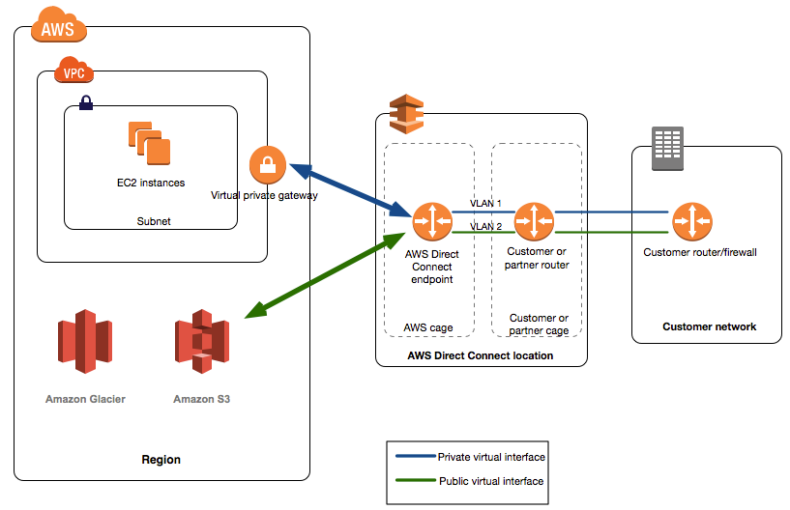
9.3: AWS Direct connect AWS Direct connect
Notes:
AWS Direct Connect lets you establish a dedicated network connection between your network and one of the AWS Direct Connect locations. Using industry standard 802.1q VLANs, this dedicated connection can be partitioned into multiple virtual interfaces. This allows you to use the same connection to access public resources such as objects stored in Amazon S3 using public IP address space, and private resources such as Amazon EC2 instances running within an Amazon Virtual Private Cloud (VPC) using private IP space, while maintaining network separation between the public and private environments. Virtual interfaces can be reconfigured at any time to meet your changing needs.

Slide 17
9.3: AWS Direct connect AWS Direct connect component
Two key components use for AWS Direct Connect.
Connection
Virtual interface
Connection :-- Create a connection in an AWS Direct Connect location to establish a network connection from your premises to an AWS region.
Virtual Interface :--
Create a virtual interface to enable access to AWS
services. A public virtual interface enables access to
public-facing services, such as Amazon S3. A private virtual
interface enables access to your VPC .
Notes:
Create a connection in an AWS Direct Connect location to establish a network connection from your premises to an AWS region.
Virtual Interface :-- Create a virtual interface to enable access to AWS services. A public virtual interface enables access to public-facing services, such as Amazon S3. A private virtual interface enables access to your VPC

Slide 18
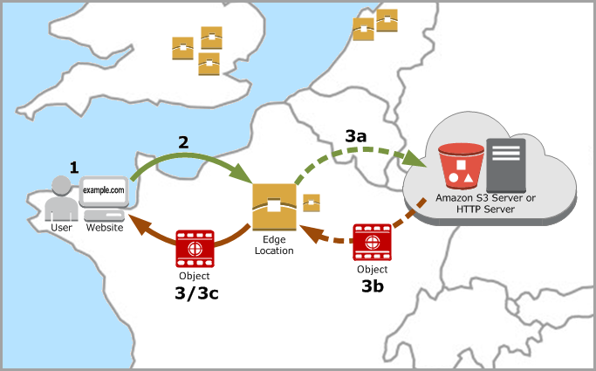
9.4: Amazon cloudfront Amazon CloudFront
Product Type : -- Content Delivery Network
Notes:
It is a global content delivery network (CDN) service that securely delivers data, videos, applications, and APIs to your viewers with low latency and high transfer speeds..
Amazon CloudFront is a highly secure CDN that provides both network and application level protection. .

Slide 19
9.4: Amazon cloudfront Benefits of Cloudfront
All CloudFront customers benefit from the automatic protections of AWS Shield Standard, at no additional charge.
It is a global content delivery network (CDN) service that securely delivers data, videos, applications, and APIs to your viewers with low latency and high transfer speeds..
.

Slide 20
9.4: Amazon cloudfront Benefits of Cloudfront
CloudFront is also seamlessly integrated with AWS WAF and AWS Shield Advanced to help protect your applications from more sophisticated threats and DDoS attacks.
Amazon CloudFront is also deeply integrated and optimized to work with popular AWS services including Amazon S3, Amazon EC2 and Elastic :Load balancing as back-end origin resources and Amazon Root 53 to help speed up DNS resolution of applications delivered by CloudFront.

Slide 21
Summary
In this lesson, you have learnt:
What is Amazon VPC
Features and benefits of VPC
What is Amazon Route 53
What is AWS Direct connect
What is Amazon CloudFront

Slide 22
Review – Questions
Question 1: ___________ is a highly available and scalable cloud Domain Name System (DNS) web service
Question 2 : _________ isolates cloud resources with your own private virtual network where you can launch AWS resources in a virtual network that you define
Notes:
Answers for the Review Questions:
Answer 1: Amazon Route 53
Answer 2: Amazon VPC

Slide 23
Review – Questions
Question 3: _________ a global content delivery network (CDN) service that securely delivers data, videos, applications, and APIs to your viewers with low latency and high transfer speeds..
Question 4: Which of the following is not an Amazon Networking service?
Option 1 : Amazon EC2
Option 2 : Amazon Route 53
Option 3 : Amazon Direct connect
Option 4 : Amazon Cloudfront
Notes:
Answers for the Review Questions:
Answer 3 Amazon Cloudfront
Answer 4: Option 1

